Slide 1
Project - 294
Team 2 :
BOOK RECOMMENDATION SYSTEM
Team Members
Subramani Prithvi
Gayathri Allumarla
Vijaya Durga Katari
Anusha Dhondi
Kotha.Nikitha
Kapil Pandurang Mane Deshmukh

Slide 2
Content
Problem statement
Data Summary
Analysis of different datasets
Data Cleaning
Outlier treatment
Imputing missing values
Different Recommendation Model
Challenges
Conclusion
Future Scope

Slide 3

Problem Statement
During the last few decades, with the rise of Youtube, Amazon, Netflix, and many other such web services, recommender systems have become much more important in our lives in terms of providing highly personalized and relevant content.
Recommendation systems aim to predict users’ interests and recommend product items that quite likely are interesting for them. They are among the most powerful machine learning systems that online retailers implement in order to drive sales.

Slide 4
Data Summary
The dataset is comprised of three csv files:: User_df, Books_df, Ratings_df
Users_dataset.
User-ID (unique for each user)
Location (contains city, state and country separated by commas)
Age Shape of Dataset - (278858, 3)
Books_dataset.
ISBN (unique for each book)
Book-Title
Book-Author
Year-Of-Publication
Publisher
Image-URL-S
Image-URL-M
Image-URL-L
Shape of Dataset - (271360, 8)
Ratings_dataset.
User-ID
ISBN
Book-Rating
Shape of Dataset - (1149780, 3)

Slide 5
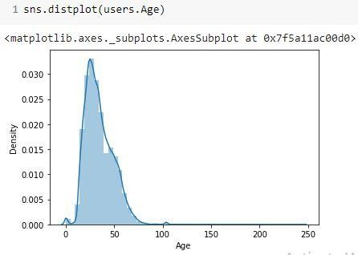
Observations from Users_df (Age)
The Age range given here is from 0 To 250.
Outliers in the Age column.

Slide 6
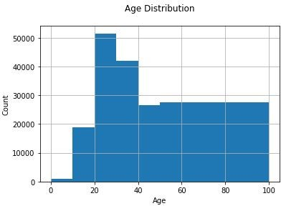
Observations from Users_df (Age)
The Age range distribution is right skewed
Most active readers lie in age group 20- 40

Slide 7
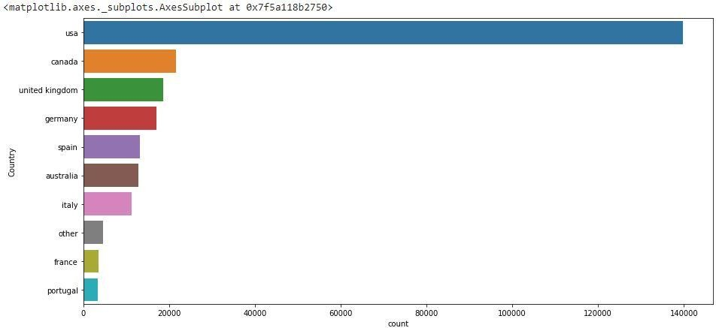
Observations from Users_df (Location)
Splitting Location column and analysing country.
Most active readers are from USA.

Slide 8
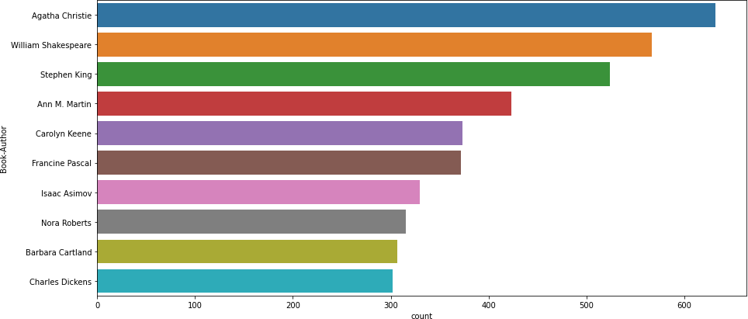
Observations from Book_df (Authors)
Agatha Christie wrote highest number of books in our given dataset

Slide 9
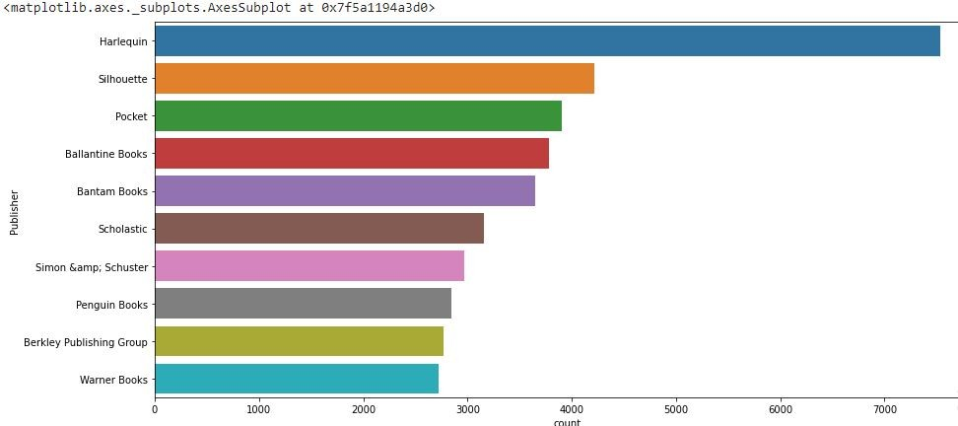
Observations from Book_df (Publishers)
Harlequin published highest number of books in our given dataset

Slide 10
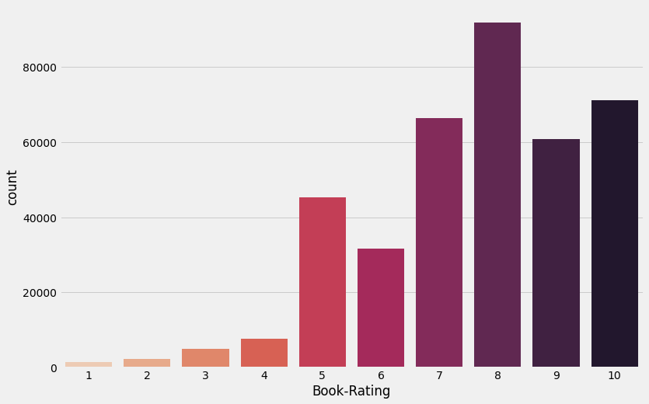
Observations from Ratings_df (Book_Rating)
Higher ratings are more common amongst users
Rating 8 has been rated the highest number of times

Slide 11
Data Preprocessing
a) Extracted the most relevant columns that are needed to recommend a book to a user.
The final columns are: ‘id’, ‘book_id’, ‘isbn’, ‘authors’, ‘original_publication_year’, ‘title’, ‘average_rating’, ‘ratings_count’, ‘small_image_url’
b) Checked null values and filled those null values because removing those null values would cause some book records to get deleted as well.
books_new = books_new.fillna('NA')
c) Saved the final dataset for recommendation.

Slide 12
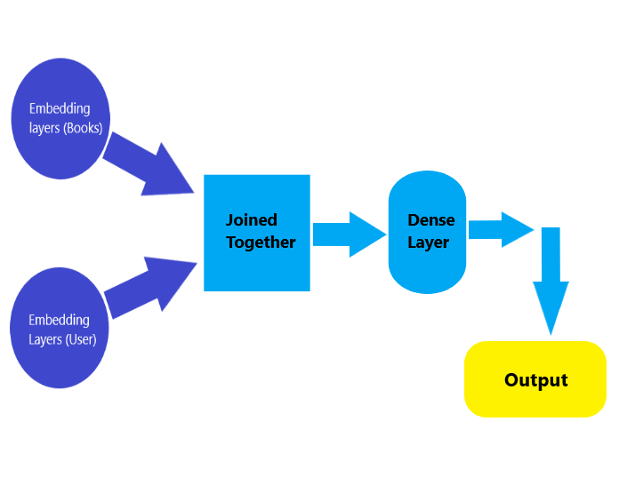
Model building
We used the ratings dataset to train our model
Splitting the dataset into train and test set (80-20 split ratio)
The Neural Network architecture we’re going to create will have two input embedding layers. The first embedding layer accepts the books, and the second the users. These two embeddings are trained separately and then combined together before being passed to a dense layer.

Slide 13
Model building ..
Stored the number of unique books and unique users in two seperate variables
Built the embedding layers for both books and users
#Embedding layer for books books_input = Input(shape=[1])#1st Input Layer embedding_layer_books = Embedding(book_id + 1,10)(books_input)#Embedding layer embedding_output_books = Flatten()(embedding_layer_books)#Embedding layer output
#Embedding layer for users users_input = Input(shape=[1])#1st Input Layer embedding_layer_users = Embedding(user_id + 1,10)(users_input)#Embedding layer embedding_output_users = Flatten()(embedding_layer_users)#Embedding layer output
Joined the two layers using tf.keras.Concatenate() and added a Dense layer on top of that with 128 neurons and a dropout layer with a dropout rate of 0.5, used Rectified linear unit as activation function. Then used the tensorflow Model class to create a single model from our defined architecture. This model is expecting two input arrays (books and users).

Slide 14
Model building ..
#Concatination and Dense layer
joining_layer = Concatenate()([embedding_output_books, embedding_output_users]) hidden_layer_1 = Dense(128, activation='relu')(joining_layer) hidden_layer_1 = Dropout(0.5)(hidden_layer_1)
output_layer = hidden_layer_2 = Dense(1)(hidden_layer_1)
model = tf.keras.Model([books_input, users_input], output_layer)
Joined the two layers using tf.keras.Concatenate() and added a Dense layer on top of that with 128 neurons and a dropout layer with a dropout rate of 0.5, used Rectified linear unit as activation function. Then used the tensorflow Model class to create a single model from our defined architecture. This model is expecting two input arrays (books and users).

Slide 15
Model building ..
Then compiled the model with Adam optimizer and customized the learning rate(0.001) and decay rate(1e-06). The loss function used here is Mean Squared error. Mean Squared error (MSE) is the average of the squared error that is used as the loss function for least squares regression: It is the sum, over all the data points, of the square of the difference between the predicted and actual target variables, divided by the number of data points
Finally trained the model on train set and validated on the test set. Then saved the model for use in the recommendation part.
Epoch 1/15
12272/12272 [==============================] - 94s 8ms/step - loss: 1.0344 - val_loss: 0.7296
Epoch 2/15 12272/12272 [==============================] - 95s 8ms/step - loss: 0.7978 - val_loss: 0.7134
Epoch 3/15 12272/12272 [==============================] - 95s 8ms/step - loss: 0.7434 - val_loss: 0.7076
Epoch 4/15 12272/12272 [==============================] - 95s 8ms/step - loss: 0.7115 - val_loss: 0.7049
Epoch 5/15 12272/12272 [==============================] - 100s 8ms/step - loss: 0.6856 - val_loss: 0.7055

Slide 16
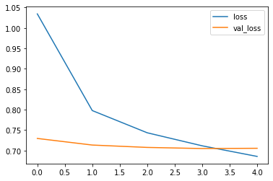
Model building ..
The loss curve:

Slide 17
Recommendation:
Loaded the model and the books and ratings dataset. The recommendations are made from the books dataset.
Defined a function that is expecting a parameter input ‘Book Title’ which is basically a unique id. The function will return a dataset containing the top 5 recommended books for that particular Book Title.
#Defining a function that will recommend top 5 books def recommend(user_id): books = pd.read_csv('books_cleaned.csv') ratings = pd.read_csv('ratings.csv') book_id = list(ratings.book_id.unique()) #grabbing all the unique books book_arr = np.array(book_id) #geting all book IDs and storing them in the form of an array user_arr = np.array([user_id for i in range(len(book_id))]) prediction = model.predict([book_arr, user_arr]) prediction = prediction.reshape(-1) #reshape to single dimension prediction_ids = np.argsort(-prediction)[0:5] recommended_books = pd.DataFrame(books.iloc[prediction_ids], columns = ['book_id', 'isbn', 'authors', 'title', 'average_rating' ]) print('Top 5 recommended books for you: \n') return recommended_books

Slide 18
Conclusion
Recommender systems are a powerful new technology for extracting additional value for a business from its user databases.
Recommender systems benefit users by enabling them to find items they like. Conversely, they help the business by generating more sales

Slide 19
Challenges
Handling of sparsity was a major challenge as well since the user interactions were not present for the majority of the books.
Understanding the metric for evaluation was a challenge as well.
Since the data consisted of text data, data cleaning was a major challenge in features like Location etc..
Decision making on missing value imputations and outlier treatment was quite
challenging as well.

Slide 20
Future Scope
Given more information regarding the books dataset, namely features like Genre, Description etc, we could implement a content-filtering based recommendation system and compare the results with the existing collaborative-filtering based system.
We would like to explore various clustering approaches for clustering the users based on Age, Location etc., and then implement voting algorithms to recommend items to the user depending on the cluster into which it belongs.

Slide 21
Thank You

